Slide 1
Weather Adaptive
ANPR System
PROJECT PRESENTATION · INTERMEDIATE REVIEW
KL 00 AA 0000
IND
Real-time number-plate recognition in fog and rain: plate detection, dehazing and a plate-specific reader
GUIDE · PROF. USHA ANAND
Auxliya Mariya
Jewel Mary Varghese
Megha T S
Silpa C R
TRV23EC020
TRV23EC030
TRV23EC039
TRV23EC066
Notes:
Introduce the project: an ANPR system that keeps reading plates when fog, haze or rain degrade the image. This review covers what has been built since the first review: the detector, the dehazing module, a new plate-specific reader and the real-time pipeline.

Slide 2
OBJECTIVES
1
Capture frames and restore plates degraded by haze, rain or low contrast, so they stay readable.
2
Detect plates and recognise the registration number in real time, with format validation and multi-frame confirmation.
3
Verify each plate against a central vehicle database and classify it as authorised, non-compliant, unauthorised, blacklisted or stolen.
4
Raise instant alerts on a real-time dashboard (vehicle details, image, timestamp) and send stolen or blacklisted vehicles to dispatch.
5
To correlate sightings across camera nodes to find convoy movement, route anomalies and loitering, and answer movement-history queries.
Notes:
Five objectives from the system brief. Plate detection and reading are done and run in real time. The weather restoration module is trained and tested offline but not yet part of the live loop. The dashboard is a prototype; dispatch is not started. Database verification and multi-node correlation are the main work for the next stage. The project is evaluated on recognition accuracy under clear and degraded conditions, restoration effectiveness, multi-node correlation accuracy and end-to-end alert latency.

Slide 3
Edge ANPR node with a five-stage pipeline
SYSTEM SPECIFICATIONS
Parameter | Design value
Pipeline | Capture → plate detection → weather restoration → plate reading → verification and alerts
Plate detector | YOLOv11n, trained on 15,000+ annotated licence-plate images
Weather restoration | CLAHE contrast enhancement; DCP and a transformer dehazing network were compared first
Plate reader | LPRNet with CTC, 200 × 24 input, characters A–Z and 0–9, Indian plate-format rules
Confirmation | Tracking plus voting over frames: announced after 5 or more agreeing reads, or on exit for short passes
Edge hardware | Jetson nano, HDR / STARVIS-class camera, NoIR plate camera with IR illuminator
Records and alerts | Central vehicle database and multi-node correlation (planned)
Development platform | Python and PyTorch on WSL2, NVIDIA RTX 4060 laptop GPU
Notes:
The design target is an edge node per camera that does detection and recognition locally and sends results to a central system. Development and testing so far run on a laptop with an NVIDIA RTX 4060 GPU; the edge target is a Jetson Nano-class board.

Slide 4
Three dehazing methods were tried on the same images
WORKING · DEHAZING METHODS
Tested on a 1,001-image hazy plate set and one real foggy road photo; results are the actual EasyOCR readings.
1
DCP
Dark Channel Prior · classical
2
Neural network
Transformer U-Net · learned
3
CLAHE
Local contrast · no haze model
HOW IT WORKS
Estimates atmospheric light and a transmission map, then inverts the haze equation.
HOW IT WORKS
A U-Net with window-attention blocks, trained on synthetic hazy and clear pairs.
HOW IT WORKS
Equalises contrast tile by tile, with a clip limit so noise is not amplified.
STRENGTH
Needs no training; a clear gain on light, uneven haze.
STRENGTH
Best reconstruction of car shape and lights; no per-image tuning.
STRENGTH
Fastest (about 1.3 ms, against 17 ms for DCP); never fails badly.
LIMIT
On dense, uniform fog it either does nothing or whitens the frame.
LIMIT
Smooths away fine edges: the worst OCR confidence of the three.
LIMIT
Inconsistent, and cannot fix blur or low resolution.
Notes:
Before choosing how to restore foggy plates, three methods were compared on the project's hazy plate set (1,001 images) and one real foggy road photo. DCP is classical and physics-based. The neural network is a U-Net with window-attention blocks trained on synthetic hazy and clear pairs. CLAHE is a local contrast method with no haze model. Every result in the next slides is the actual EasyOCR reading produced during testing, not a visual impression.

Slide 5
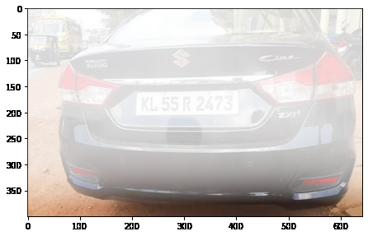
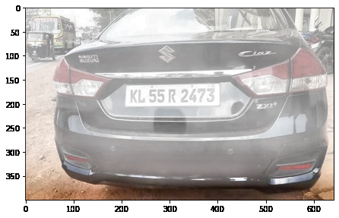
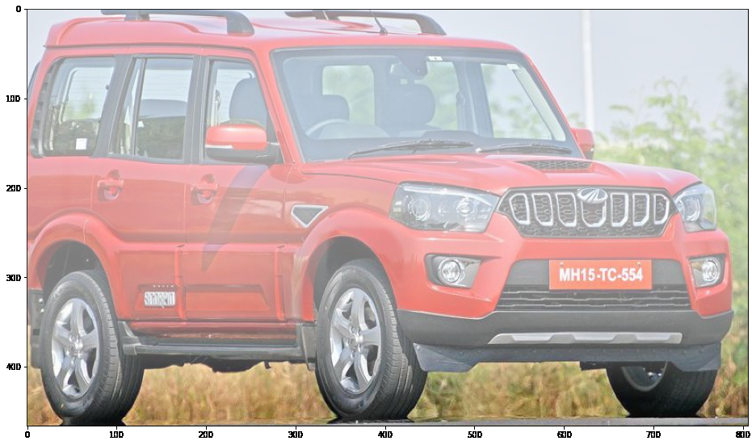
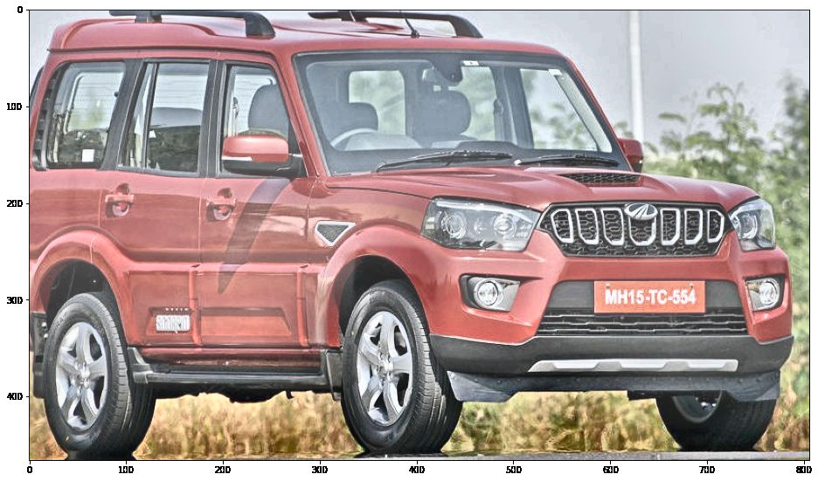
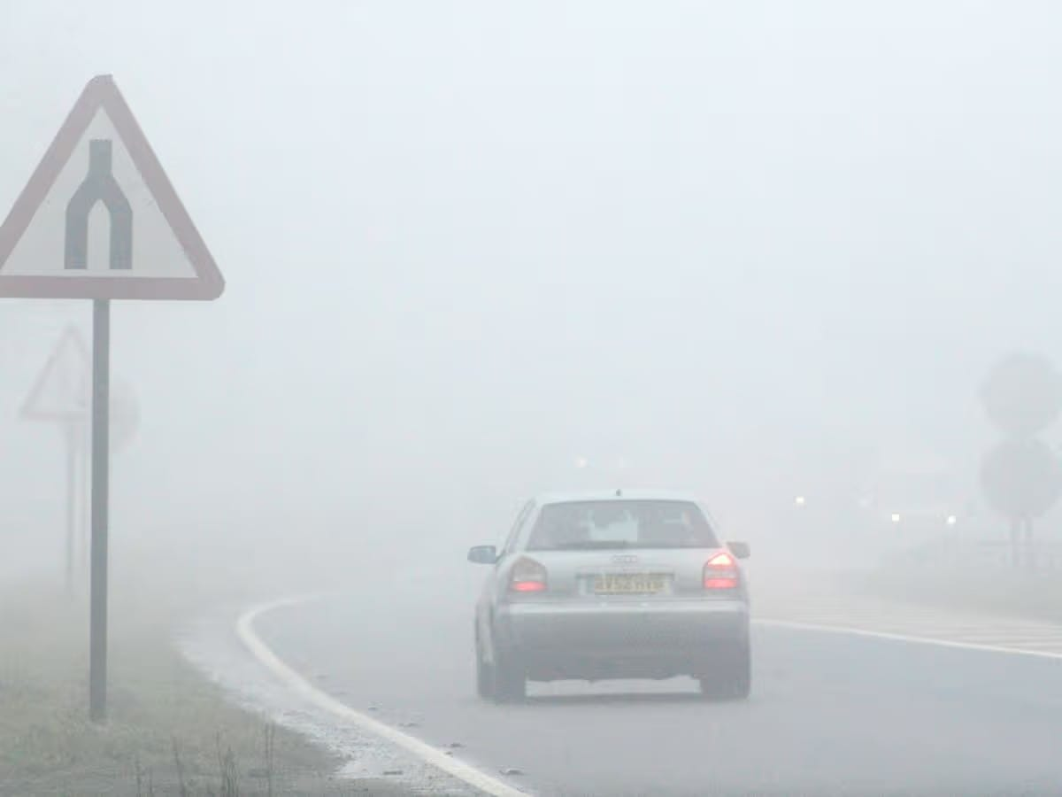
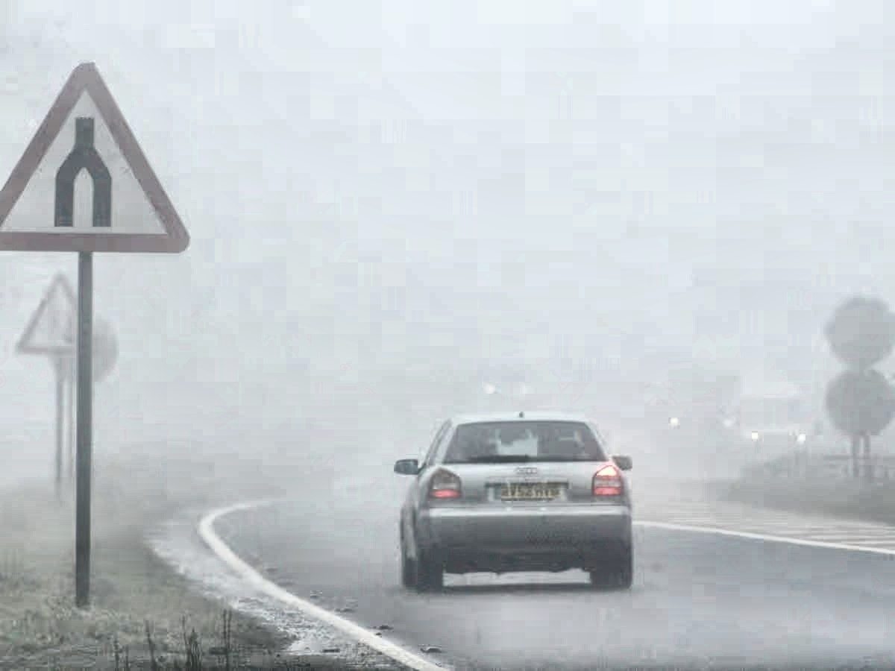
CLAHE
WORKING · CLAHE
Recovered
Made worse
No signal
Input
CLAHE
Input
CLAHE
Input
CLAHE
No plate text found in the input or after DCP. After CLAHE: “KL 55R 2473” at 0.774.
Plate reading “MH15 TC 554” (0.227) became “Mh15-Tc*4” (0.097): the local contrast boost hurt it.
Real fog photo: scene contrast improves, but the plate is only about 33 px tall and blurred, so no method reads it.
Across the five test scenes CLAHE helped decisively once, hurt once and made no difference on the rest; it cannot fix blur or low resolution.
Notes:
CLAHE was tested on five scenes. On the moderate-haze photo it was the only method that recovered a fully readable plate, KL 55R 2473 at confidence 0.774, where the raw input and DCP found nothing. On the mild-haze photo it made the plate reading worse, from 0.227 to 0.097. On the real foggy road photo the scene contrast improved, but the plate is only about 33 pixels tall with real optical blur, which no contrast method can fix. The same clip limit and tile size were used on every example.

Slide 6
LPRNet
WORKING · PLATE READER
Layout
Two-line plates are flattened into one row before reading.
Character error on 21 held-out scenes (lower is better)
1
LPRNet + CTC
A CNN reads the crop left to right; no character segmentation.
2
Format rules
Letter and digit slots (e.g. KL 01 AB 1234) are enforced using the network's own probabilities.
3
Voting
Readings from many frames are voted; a plate is confirmed after 5 or more agree.
4
Notes:
EasyOCR is a general scene-text reader and failed on weather-degraded plates. LPRNet is a small CNN with CTC loss that reads the whole plate in one pass. Trained from scratch on 218 labelled scenes it overfitted, because they held only about 197 different plates. Pretraining on synthetic plates, then fine-tuning on real ones, brought the character error from 0.70 to 0.32, and adding CCPD data and mixing in synthetic plates took it to 0.249. The chart uses the same 21 held-out scenes throughout.

Slide 7
Real labelled plates lifted every test set
RESULT · REAL-DATA TRAINING
Plates read exactly (%)
6.7 → 9.0 of 16
Kerala plates read exactly after adding the Zenodo set (mean of 3 seeds)
19 → 23 of 27
Unseen video 4, after two rounds of real-video labelling
38 → 41 of 51
Six test videos never used for training (second round)
Notes:
Synthetic tricks plateaued, so real plates were labelled instead. Kerala photos plus the public Zenodo set raised exact reads on 16 held-out Kerala plates from 6.7 to 9.0 (mean of three seeds). Crops from traffic videos were then labelled in two rounds, with one typed plate per tracked vehicle. On unseen video 4, exact plates rose from 19 to 23 of 27 over both rounds. On the six test videos, which were never used for training, the second round raised 38 to 41 of 51.

Slide 8
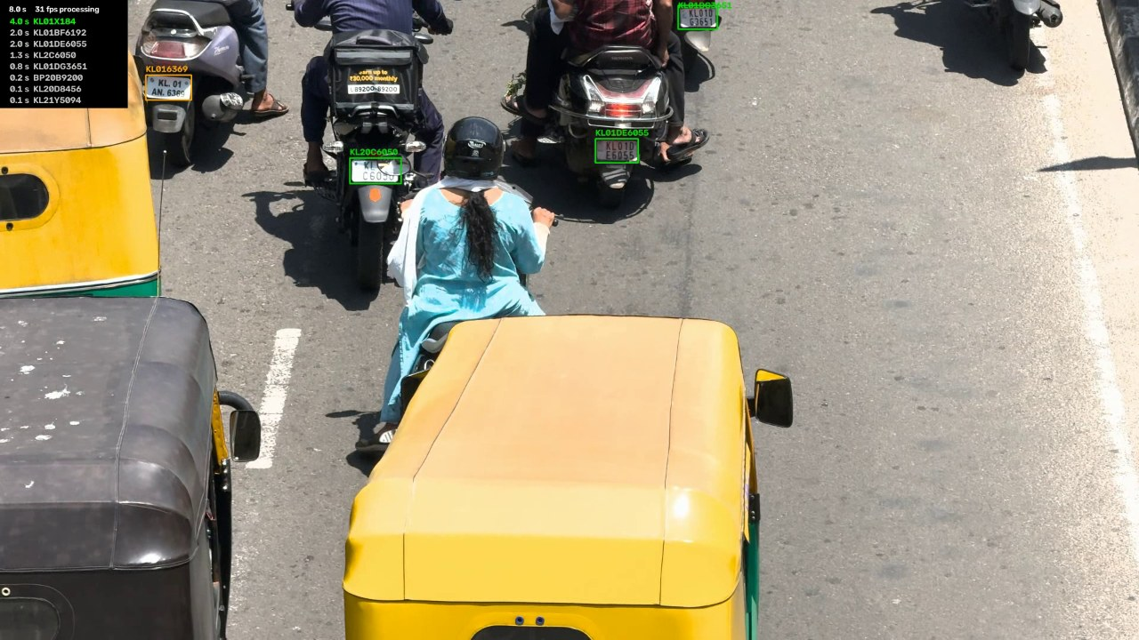

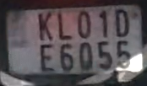


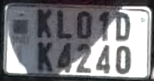

Real Time Output
RESULT
≤ 55 fps
10 of 12
1080p; about 20–30 fps at 4K
plates exact, unseen 4K video
Announced plates
KL01DG3651 ✓
KL01DE6055 ✓
KL01AN6369 ✓
Live view: boxes and readings on the plates; confirmed plates and their times listed at top left
KL01CN1695 ✓
KL01DK4240 ✓
KL2C6050 ✗
✗ True plate is KL20C6050: one digit dropped.
Notes:
The live pipeline runs detection, tracking, reading and voting frame by frame, and shows each plate as soon as it is confirmed. The recent plates are listed at the top left of the video. It runs at up to 55 frames per second on 1080p video on the laptop GPU and about 20 to 30 on 4K. On this unseen 4K test video, 10 of 12 real plates were read exactly: one dropped a digit (KL2C6050 for KL20C6050) and one plate was partly hidden by a shadow. A phone-number sign on a scooter was also announced as a plate; a state-code check is planned to remove that. An earlier unseen 4K video gave about 31 of 40 plates right.

Slide 9
Reader and detector work; verification is next
INFERENCE
1
The plate detector is reliable. YOLOv11n reaches 99.2 % mAP@50 (precision 98.5 %, recall 99.0 %) on 15,000+ plate images.
2
Dehazing clears the scene but does not fix OCR alone. Dehazed crops read slightly worse (36.3 % vs 40.5 %) because the reader had only seen raw crops.
3
A plate-specific reader was needed. EasyOCR read 16.5–25.2 % of fog plates exactly; LPRNet now reads 10 of 12 plates on an unseen 4K video.
4
It runs live. Detection, tracking, reading and voting run at up to 55 fps on 1080p (about 20–30 fps at 4K) on a laptop GPU.
5
Known gaps. Three equal digits are dropped, non-Kerala series are weaker, and small or faded plates and road signs cause misses or false plates.
6
Next: verification and alerts. Vehicle database, dashboard and alerts, dispatch, multi-node correlation, weather routing in the live loop, and edge deployment with field tests.
Notes:
Summary of the intermediate stage. The detector and the plate reader work and run in real time. Dehazing helps images but needs the reader to be trained on its output before it improves OCR. The known gaps are repeated digits, non-Kerala series, small or faded plates and signs read as plates. The remaining work is the system layers around recognition: the vehicle database and alerts, the dashboard, multi-node correlation, putting weather routing into the live loop, and edge deployment with field tests.

